Slide 1
TOPIC:Java architecture PRESENTED BY:JAYASRI J BE(ECE)IV YEAR

Slide 2
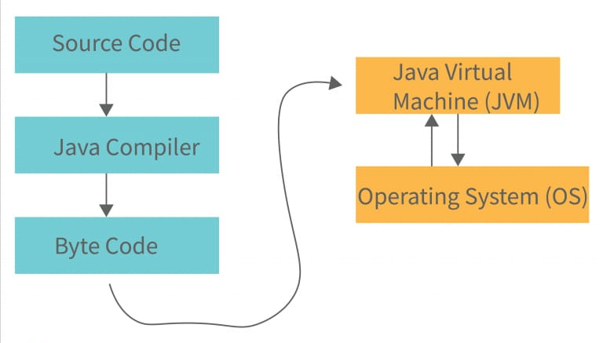
Introduction to Java Architecture:
Optimizing Performance: Understanding the inner workings of JVM, JDK, and JRE helps developers write more efficient code and optimize resource usage.
Debugging and Troubleshooting: Knowledge of memory management, garbage collection, and security mechanisms aids in solving complex problems.
Building Cross-Platform Applications: Java’s architecture allows for seamless deployment across different platforms, making it essential to understand for scalability.
Leveraging Security Features: Java’s built-in security model can help developers create more secure applications, especially in web and enterprise environments.

Slide 3
Java Platform Overview:
Java Platform refers to the combination of Java Virtual Machine (JVM), Java Development Kit (JDK), and Java Runtime Environment (JRE) that together provide the environment for developing and running Java applications.
JDK: Contains tools required for Java development (compiler, libraries, etc.)
JRE: Provides the runtime environment to run Java applications (includes the JVM and core libraries).
JVM: Core part of the platform, responsible for executing Java bytecode on any operating system.

Slide 4
Components of Java Architecture:
JAVA DEVELOPMENT KIT(JDK):
DEFINITION:
The JDK is a complete software development kit used for developing Java applications.
COMPONENTS:
Compiler (javac): Converts Java source code into bytecode.
Debugger: Helps identify and fix errors in the program.
Other Tools: Includes javadoc (documentation tool), jar (packaging tool), and other utilities.
PURPOSE:
Provides all necessary tools for writing, compiling, and testing Java code.

Slide 5
2) Java Runtime Environment (JRE):
Definition:
The JRE is a subset of the JDK that allows users to run Java applications.
Components:
JVM: Executes Java bytecode.
Core Libraries: Includes classes that handle input/output, networking, data structures, and more.
Purpose:
Provides the runtime environment for Java programs to run but does not include development tools like the compiler.

Slide 6
3) Java Virtual Machine (JVM):
Definition:
The JVM is the engine that drives Java applications. It interprets or compiles Java bytecode into machine code specific to the operating system.
Key Functions:
Classloader: Loads class files into memory.
Bytecode Verifier: Ensures bytecode is valid and safe to execute.
Execution Engine: Executes the loaded bytecode.
Garbage Collection: Manages memory by automatically removing unreferenced objects.
Platform Independence:
The JVM allows Java applications to run on any system by translating bytecode to native machine code.

Slide 7
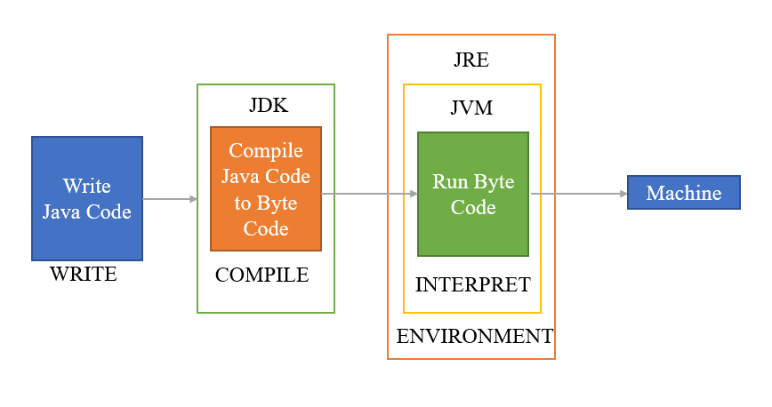
BLOCK DIAGRAM OF JDK,JRE,JVM:

Slide 8
EMPHASIZING PLATFORM INDEPENDENCE AND MANAGE RUNTIME:
Platform Independence: Java’s "Write Once, Run Anywhere" capability is made possible by the JVM, allowing Java applications to run on any operating system without modification.
Managed Runtime: Through features like Garbage Collection, the JVM manages memory, improving efficiency and reducing the risk of memory leaks or corruption.

Slide 9
PERFORMANCE AND SECURITY:
Performance:
Just-in-Time (JIT) Compilation: Enhances performance by converting bytecode into native machine code during execution, speeding up frequently used code paths
Memory Management: Automatic garbage collection and optimized memory allocation improve runtime efficiency.
Security:
JVM's Security Mechanisms: Ensures secure execution through bytecode verification and sandboxing, preventing malicious code from compromising the system.
Security Manager and Permissions: Fine-grained control over what Java applications can access, offering a robust security model.

Slide 10
CONCLUSION:
Java Architecture is the backbone of one of the most widely used and versatile programming languages in the world. The combination of the Java Development Kit (JDK), Java Runtime Environment (JRE), and Java Virtual Machine (JVM) allows for the development and execution of applications that are platform-independent, secure, and efficient. Understanding the architecture is crucial for developers to leverage the key benefits that Java offers:
Platform Independence
Managed Runtime
Performance and Security

Slide 11


